Slide 1


Rational Decision Making A.I

Slide 2
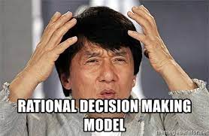
WHAT IS RATIONALITY
RATIONALITY:
is the quality of being based on or in accordance with reason or logic.
DECISION MAKING
“the act of choosing between two or more possibilities’.

Slide 3

RATIONAL DECISION MAKING
Rational decision making is a process of reaching a decision that maximizes utility and these decisions are arrived at based on relevant information and by applying sound logic and optimizing resources.
Suppose we compare two ways of moving from A to B. The first choice is to use a car and the second one is to use a bicycle. The rational way is not just to select the choice which minimizes time but to compare this with the cost of the action.

Slide 4
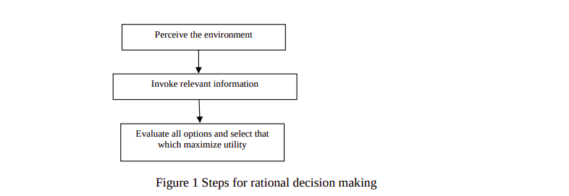
STEPS FOR RATIONAL DECISON MAKING

Slide 5

PERCEIVE THE ENVIRONMENT
undertaking a rational decision making process one studies the environment or more technically a decision making space.
Formulating the problem (which involves its detection, identification and definition

Slide 6
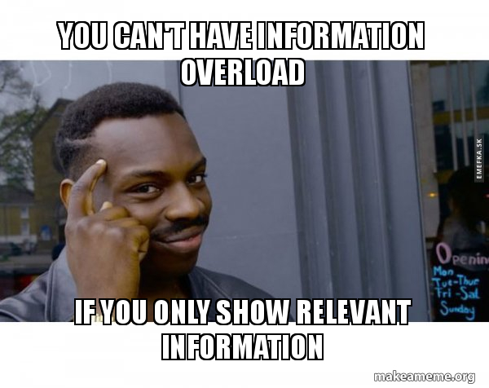
INVOKE RELEVANT INFORMATION
Then the next step is to identify relevant information necessary for decision making
a). Understand the facts and place the facts into proper relationship with each other.
b). A great deal of analytical thinking may be required to identify the essential facts and analyze the relationship between them.

Slide 7
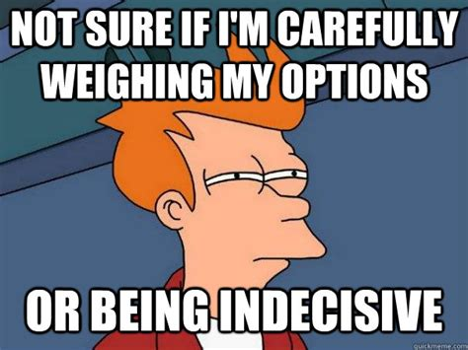
EVALUATE ALL OPTIONS AND SELECT THAT WHICH MAXIMIZE UTILITY
Then this information is presented to a decision engine which is logical and consistent and evaluates all possibilities and their respective utilities and then selects the decision that offers the highest utility

Slide 8
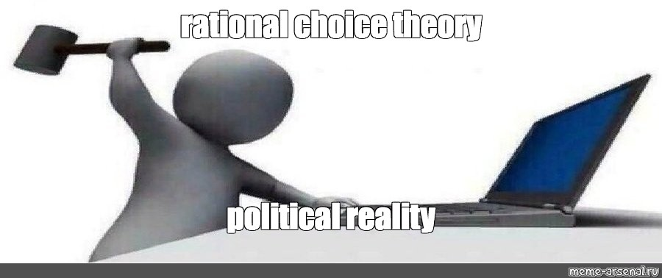
Rational Choice
The theory of rational choice state that given several options a rational human being will choose that option that maximizes his utility

Slide 9
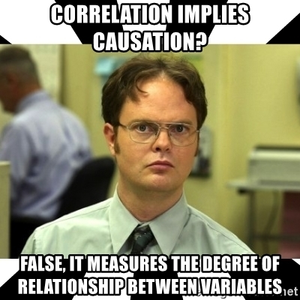
CONCLUSION
"Correlation is not causation" means that just because two things correlate does not necessarily mean that one causes the other.

Slide 10
THANK YOU

